Slide 1
Multiple Linear Regression Using Python
Dhruv Suryavanshi

Slide 2
Overview
The project is aimed to provide insights on the 1990 SAT scores.
Using Multiple Linear Regression(MLR) and Simple Linear Regression(SLR), we observe the combined and individual effects of 6 variables on csat(Composite SAT Score), respectively.
Python is used to visualize plots and perform regression analysis.

Slide 3
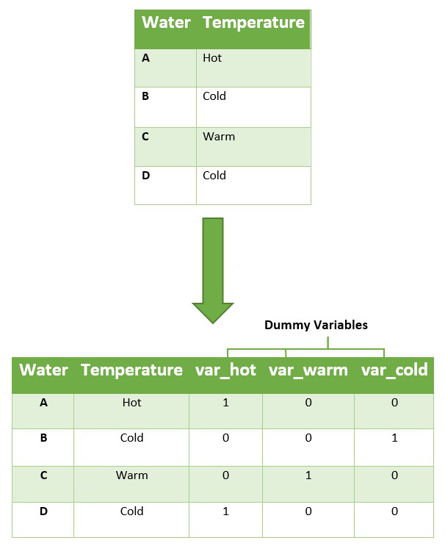
Dummy variables and why do we use them?
Dummy variables are used to convert non-numeric categorical variables into separate numeric variables which take values of ‘0’ or ‘1’. For e.g. Consider a variable “Temperature” having 3 values ; Hot, Cold, Warm.
The sampling units where the temperature of water is “hot”, the dummy variable var_hot will take value 1 and all other dummy variables i.e. var_cold and var_warm will take values 0.
This process is repeated for all sampling units.

Slide 4
Why Adjusted R² ?
R² | Adjusted R²
Explains the variability in the response variable(Y) with respect to our fitted regression model. R² assumes that every single variable explains the variation in Y. | Adjusted R² also explains the variability in the response variable(Y). But instead, Adjusted R² explains the variability explained by the variables that actually affect Y.
Problem with R² that is corrected through adjusted R² :
R² increases with every regressor(X) added to a model. It appears to be a better fit as you keep on adding more and more terms to the model, even when these variables are completely useless. This leads to misleading inferences.

Slide 5
What is p-value? What does it tell you?
p-value(probability value) tells us the statistical significance of a particular variable in the regression model.
For p <= 0.05, we reject the null hypothesis, that, a variable(X_{i}) has no correlation with the dependent variable(Y), i.e. the variable(X_{i}) is correlated to Y and has a contribution in determining Y.
For p > 0.05, we accept the null hypothesis that a variable(X_{i}) has no/negligible correlation with the dependent variable(Y), i.e. the variable(X_{i}) is not correlated to Y and has no/negligible contribution in determining Y.

Slide 6
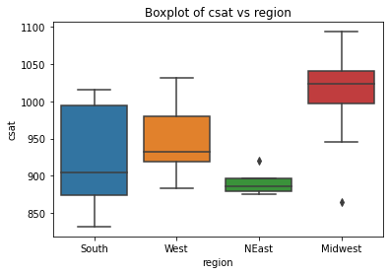
Region-wise Boxplots
In the boxplot, we see a large variability in the scores of Southern states which indicates that the data is well-dispersed while the North Eastern states show very less variability in scores.
We see some outliers present in the scores of Northeast and Midwest regions. Outliers are data points that differ significantly from the other data
The mid-west students have exceptionally higher scores as compared to other regions.

Slide 7
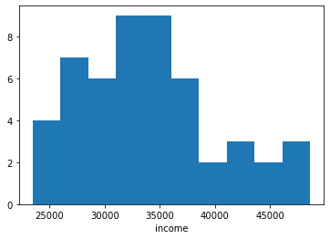
Introduction to Variables
In the dataset, we have the following information :
csat : Composite SAT Score (Y)
percent : Percentage of High School graduates taking SAT
expense : Per pupil expenditures
income : Median household income
high : % of people over 25 with HS Diploma
college : % of people over 25 with Bachelor’s
degree
We also have a categorical variable “region”
taking 4 values; West, North-east, South,
Mid-west.

Slide 8
MLR RESULTS
R² : 0.913
Adjusted R² : 0.896
Variable | Coefficient | p - value
Intercept | > -0.01 | 1
percent | -1.18 | <0.01
expense | -0.1 | 0.18
income | 0.04 | 0.57
high | 0.19 | 0.04
college | 0.21 | 0.01

Slide 9
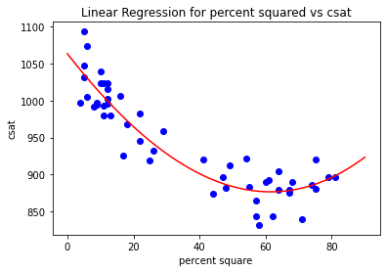
Why not percent²?
On observing the graphs and SLRs of percent and percent² we see that percent² fits much better than percent.
But, when we use percent² in our model instead of percent the value of R² reduces significantly which indicates a poorer fit.
Also, we cannot use percent along with percent² as it contributes to huge multicollinearity in the model which would make the model less reliable.

Slide 10
Inferences
After performing MLR, we find the adjusted R² to be 0.896 i.e. our regression model explains 89.6% of the variability in csat.
Looking at the standardized coefficients, we can say that when the percentage of high school graduates taking SAT(percent) and per pupil expenditure(expense) increases by 1 unit the composite SAT score decreases by 1.18 and 0.1, respectively.
Rest all variables show a positive correlation with the composite SAT score, meaning as they increase, the SAT score increases.

Slide 11
Inferences
The median income has shown a weak positive correlation with the SAT scores.
The higher p-values of income and expense suggest that they have negligible contribution in determining the SAT scores.
Whereas the p-values of percent, high and college are well below 0.05 making them the prime contributors in determining SAT scores.
No wonder the SAT scores depend heavily upon the previous knowledge and merits of the candidate(percent, high, college) rather than their income or expenses on studies.

Slide 12
References
https://stackabuse.com
https://www.youtube.com/c/joshstarmer
https://statisticsbyjim.com
https://www.geeksforgeeks.org
https://www.statology.org
https://towardsdatascience.com

